Slide 1
JavaScript
152-168 Class 5

Slide 2
HTML Forms
<form> .. </form> tags surround a collection of <input> elements
Usually sends data to a server for processing
Fires a submit event

Slide 3
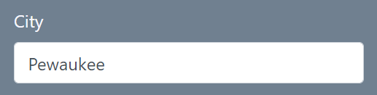
Name/Value Pairs
Every <input> has a name="..." attribute
<input type="text" name="city">

Slide 4
Name/Value Pairs
When submitted, the form combines the input's name with the value entered by the user
<input type="text" name="city">
city=Pewaukee

Slide 5
Then What?
Form data, as name-value pairs, can be sent two ways:
Out in the open (GET)
Hidden away (POST)

Slide 6
Form Method: GET
<form method="get"> sends name-value pairs in the query string
Appended to the URL
Try it out here: https://www.oroborous.com/querystring/submitme.html

Slide 7
Form Method: POST
<form method="post"> sends name-value pairs in the request body
Not in the URL

Slide 8
Form Methods Comparison
GET
POST
Form values sent in query string
Insecure
Can be bookmarked
Limited to ~1024 characters
Can only send text data
Form values sent in request body
Can be encrypted for security
No size restrictions
Can send any data type

Slide 9


Where Are Form Values Sent?
Usually a server is listening for requests
The server address is the form's action
<form method="get" action="register.php">
register.php

Slide 10
Defaults
What is this form's method? Its action?
<form>
<input type="text" name="city">
<button>Register</button>
</form>

Slide 11
Defaults
GET is the default method
The default action is the current URL
<form>
<input type="text" name="city">
<button>Register</button>
</form>

Slide 12
Client-Side Forms
We don't have a server, but we can still use a <form>
But we have to stop the <form> from actually submitting (trying to send its values somewhere)

Slide 13
jQuery Submit Listener
jQuery can listen for the form's submit event
Pressing enter or clicking the submit button will trigger submission
$("form").submit(placeOrder);

Slide 14
Prevent the Default Action
Add a parameter to your event listener function
event or e are commonly used
function placeOrder(event) {
event.preventDefault();
// ...your other code
}

Slide 15
Flashing, Resetting Form
Without event.preventDefault(), your form will reset itself
There will be values at the end of the URL

Slide 16
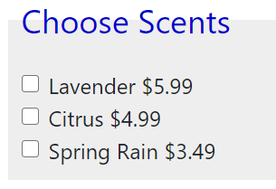
Checkboxes
Allows the user to select none, some, or all options
A group of checkboxes all have the same name="..." attribute
<input type="checkbox" name="soap">

Slide 17
Name vs. ID
Checkboxes should have the same name, but different IDs
<input type="checkbox" name="soap" id="soap-lavender">
<input type="checkbox" name="soap" id="soap-citrus">

Slide 18
Checkbox Labels
Include a label for each checkbox (by ID)
<input type="checkbox" name="soap" id="soap-citrus">
<label for="soap-citrus"> Citrus $4.99 </label>

Slide 19
How Many Boxes Were Checked?
Sometimes you want to know how many checkboxes in a group were checked
First, ask jQuery to find all of them
var checkedBoxes = $("input[name=soap]:checked");

Slide 20
.length Property
The .length property is the number of things jQuery selected
var numSelections = checkedBoxes.length;

Slide 21
Extra Information
In the JavaScript, we want to add the cost of each checked box
How will JavaScript know that the cost of the "soap-citrus" checkbox is 4.99?

Slide 22
Data Attributes
You can add extra information to the HTML in data attributes
Like variables for HTML!
<input type="checkbox" name="soap" id="soap-citrus" data-price="4.99">

Slide 23
data-*
Starts with data-
No uppercase letters after dash
All data- attributes are ignored by the browser
data-country="USA"
data-element="boron"
data-star-rating="4.9"
data-author="Hemingway"
data-zip-code="54751"
data-card-suit="clubs"

Slide 24
Add Price Info to Checkbox HTML
<input type="checkbox" name="soap" id="soap-lavender" data-price="5.99">
<input type="checkbox" name="soap" id="soap-citrus" data-price="4.99">
<input type="checkbox" name="soap" id="soap-spring-rain" data-price="3.49">

Slide 25
Find Total Price with jQuery
Ask jQuery to find all checked checkboxes
Sum their data-price values
First, create a total variable
var total = 0;

Slide 26
jQuery, Find Me All Checked Boxes
Selector matches all <input> elements where the name is "soap" and it is checked
var checkedBoxes = $("input[name=soap]:checked");

Slide 27
jQuery's each()
For each checked box, add it's data-price value to the total
Works like a loop over the selected checkboxes
checkedBoxes.each(function() {
total += $(this).data("price");
});

Slide 28
jQuery's data()
What is this? One of the checkboxes
Don't include the data- when getting data-price
$(this).data("price");

Slide 29

No Number Parsing!
data() will parse the value if it's a number!
See https://api.jquery .com/data/ for other data types it will parse

Slide 30
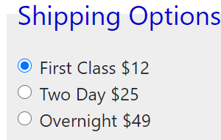
Radio Buttons
Same rules as for checkboxes
Same name, different IDs
Use a <label>
Used when the user must select exactly one option

Slide 31
Check One Radio Button
One radio button should be checked by default
<input type="radio" name="shipping" id="shipping-fc" data-shipping-fee="12" checked="checked">

Slide 32
Find the Checked Radio Button
There should only be one checked radio button
Get its data-shipping-fee value
var shipping = $("input[name=shipping]:checked") .data("shipping-fee");

Slide 33
Adding Styles with jQuery
jQuery can add CSS rules directly to elements
Let's style this paragraph
<p id="output">Hello world!</p>

Slide 34
Change Color with .css()
Foreground color
$("#output").css("color", "red");
Background color
$("#output").css( "background-color", "blue");

Slide 35
Add Any Style Rule
Padding
$("#output").css("padding", "10px");
Bold font
$("#output").css("font-weight", "bold");

Slide 36
Style Cleanup
Removes all styles added with .css()
Any styles from a stylesheet will remain
$("#output").removeAttr("style");

Slide 37
Lab
See Canvas for the Greeting Radio Button lab

Slide 38
Two More Events
Change event fires when an <input>'s value changes
For example, when...
A checkbox is checked or unchecked
Text in a text box changes

Slide 39
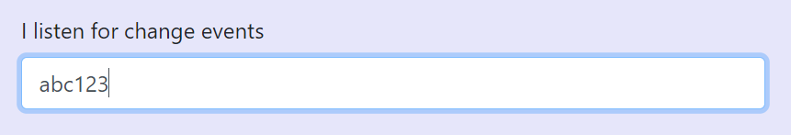
When Does the Value Change?
The value of a text box doesn't change until the box loses focus or enter is pressed
<input type="text" id="firstTextBox">

Slide 40
Listen with jQuery
Like .click and .submit, can set a function to run on the .change event
$("#firstTextBox").change(myFunction);

Slide 41
Keypress Events
Unlike .change, the .keypress event will fire after every key press
$("#secondTextBox") .keypress(anotherFunction);

Slide 42
What Key Was Pressed?
What if we want to know what key was pressed?
JavaScript always provides an event object that contains information about the event that just happened
What element was clicked, what key was pressed, etc.

Slide 43
Event Parameter
Include an event parameter in the function
function anotherFunction(event) {
var character = event.key;
}

Slide 44
Lab
See Canvas for Order Form lab

Slide 45
Bootstrap Tabs Demo
Uses an unordered list as navigation
All the "tabs" are <div> elements in a single HTML
Hide and show based on tab clicks

Slide 46
Lab
See Canvas for the jQuery Tabs lab

